Slide 1

PROJECT TITLE: SMART PPE COMPLIANCE CHECKER
TEAM NAME: THE DEVIONS
TEAM MEMBER:
MOHAMMED MUDASSIR
B. KEERTHI REDDY
S. LAHARI
V. KOUSHIK

Slide 2
PROBLEM STATEMENT :
Workplace accidents remain a critical challenge in industries such as construction, manufacturing, and mining, with a major cause being non-compliance with Personal Protective Equipment (PPE) protocols. Traditional monitoring methods—like manual supervision or basic CCTV review—are often slow, inconsistent, and error-prone, leaving safety gaps that lead to injuries, downtime, and financial losses. There is a strong need for a real-time, automated, and scalable solution that ensures workers consistently follow PPE rules while reducing reliance on manual checks.

Slide 3
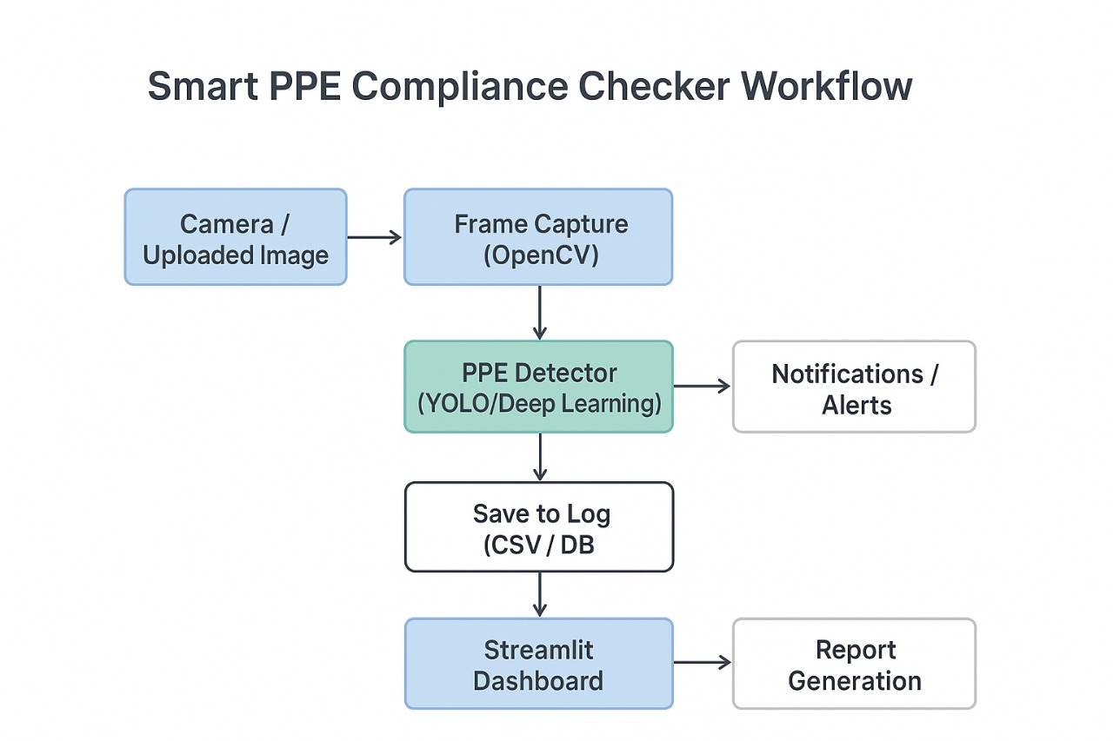
WORKFLOW:

Slide 4
Existing Approaches:
Manual checks → slow, error-prone, not scalable
CCTV with no automation → only post-incident review
Expensive AI tools → high cost, rigid, limited flexibility
Our Solution:
PPE Condition Monitoring → Detects damaged or worn-out PPE before accidents
Behavior Awareness → Identifies unsafe postures & improper PPE usage in real-time
Role-Specific Compliance → Different PPE rules for welders, electricians, doctors, etc.
Predictive Analytics → Forecasts accident risks using compliance trends
Emergency Integration → Auto-alerts via sound, email & IoT sirens for quick response
Gamification → Points, badges & leaderboards to boost safety engagement
Real-Time Dashboard → Live monitoring & analytics visualization for supervisors

Slide 5
TECHNOLOGY STACK:
AI & CV: YOLOv9, OpenCV, MediaPipe
Backend: Python, FastAPI
Analytics: Pandas, Scikit-learn, Matplotlib
Dashboard: Streamlit
Edge Deployment → Run on devices like Raspberry Pi / Jetson for low-cost, on-site monitoring
Cross-Industry Use → Extend to mining, healthcare, labs, factories, and logistics
IoT & Wearables Integration → Smart helmets, safety vests, sensors for richer safety data
AI Risk Prediction → Forecast accident-prone zones/shifts using historical data
Cloud & Mobile Dashboard → Centralized monitoring with mobile app access

Slide 6
Business Model:
Target Users
Construction, Manufacturing, Mining, Oil & Gas, Healthcare
Revenue Streams:
SaaS Subscription → Pay per camera/month
Enterprise Licensing → One-time fee for big orgs
Freemium → Premium → Free basic, paid advanced features
Customization → Industry-specific compliance rules
Data Insights → Safety analytics & risk reporting
Value Proposition:
Affordable → Uses existing cameras
Scalable → From small sites to enterprises
Proactive → Prevents accidents early
Customizable → Role/industry-specific rules
Engaging → Gamification for workers

Slide 7
FUTURE SCOPE:
Blockchain for Compliance Logs → Immutable safety records for audits & regulatory transparency
IoT & Wearables Integration → Smart helmets, connected safety vests, biometric sensors, RFID tags
Cloud & Mobile Dashboard → Centralized monitoring, mobile app access, role-based analytics

Slide 8
CONCLUSION:
The Smart PPE Compliance Checker successfully transforms traditional workplace safety monitoring into an AI-powered, real-time, and proactive solution. Unlike existing systems that only detect PPE presence, our system goes further by integrating condition monitoring, behavior analysis, role-specific compliance, predictive analytics, privacy protection, emergency response, and gamification — creating a comprehensive safety ecosystem.
With its affordable deployment using standard cameras, customizable rules, and real-time alerts, it not only prevents accidents instantly but also empowers organizations to build a culture of safety. The project is fully implemented, tested, and ready for real-world deployment, with future potential for multi-camera support, mobile apps, cloud integration, and IoT-driven safety automation.

